Slide 1

ScreenSense:Kids’ Screentime Visualization
By :Saurav Agrawal

Slide 2


Project Overview and Timeline
This implementation plan breaks down our analytics initiative into four key milestones, each building upon the previous phase to ensure comprehensive data understanding and insight generation.
01
02
Data Foundation
Visual Exploration
Weeks 1-2: Establish clean, structured datasets with engineered features ready for analysis
Weeks 3-4: Uncover patterns through comprehensive univariate and bivariate analysis
03
04
Segment Deep-Dives
Report & Present
Weeks 5-6: Identify key cohorts and behavioral patterns across demographics
Weeks 7-8: Deliver interactive dashboards and comprehensive documentation

Slide 3



Milestone 1: Data Foundation and Cleaning
Week 1: Project Initialization
Week 2: Preprocessing & Features
Establish the groundwork for success by clearly defining objectives and understanding the dataset structure.
Transform raw data into analysis-ready format through strategic cleaning and feature creation.
Define project goals and analytical workflow
Handle missing values and inconsistencies
Load dataset and explore schema
Create age bands and temporal flags
Examine data types, size, and null values
Calculate device and activity shares
Document initial quality observations
Save preprocessed data with documentation
Deliverables: Cleaned dataset, preprocessing summary, and comprehensive feature dictionary

Slide 4
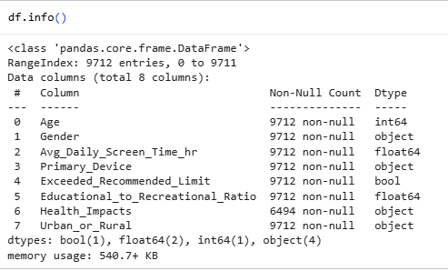





Week 1 Deep Dive: Laying the Groundwork
Define Goals
Establish clear objectives and success criteria for the analysis project
Load Dataset
Import data and verify successful loading across all required sources
Explore Schema
Analyze structure, data types, and relationships between variables
Quality Check
Identify null values, outliers, and potential data quality issues

Slide 5
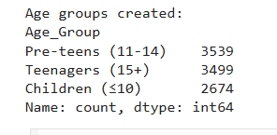
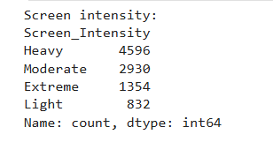
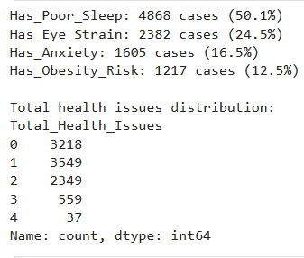

Week 2 Focus: Feature Engineering Excellence
Transform raw variables into meaningful analytical dimensions that unlock deeper insights and enable sophisticated segmentation strategies.
1
Missing Value Treatment
Apply imputation strategies or exclusion rules based on data missingness patterns and business logic
2
Category Standardization
Resolve inconsistent categorical values and establish uniform naming conventions
3
Derived Fields Creation
Engineer age bands, weekday/weekend flags, and device/activity share metrics
4
Temporal Formatting
Standardize date/time fields to enable chronological analysis and pattern detection

Slide 6
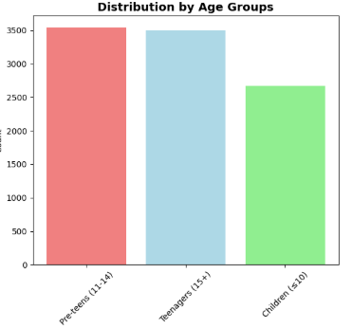

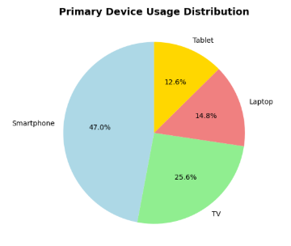





Milestone 2: Visual Exploration and Trends
Weeks 3-4 focus on revealing patterns through systematic visual analysis, comparing distributions across demographics and uncovering usage behaviors.
Week 3: Core Distributions
Analyze daily hours, age bands, and device usage through histograms, boxplots, and comparative visualizations across gender, age, and location
Week 4: Behavioral Patterns
Compare device mix and activity categories across demographics, highlighting weekday versus weekend differences and temporal usage patterns
Deliverable Target: Minimum 8 high-quality visualizations with documented observations on peak usage cohorts

Slide 7
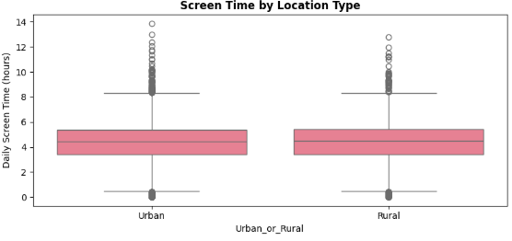



Milestone 3: Segment and Insight Deep-Dives
Week 5: Cohort Analysis
Identify and profile the most significant user segments through multi-dimensional analysis.
Pinpoint top cohorts by age bands and device types
Create heatmaps showing engagement intensity
Build stacked comparisons across demographics
Analyze location-based segment differences
Week 6: Temporal Patterns
Uncover seasonal variations and habit formations that drive user behavior over time.
Compare monthly or term-time engagement levels
Identify calendar-driven usage spikes
Document drivers behind segment behaviors

Slide 8
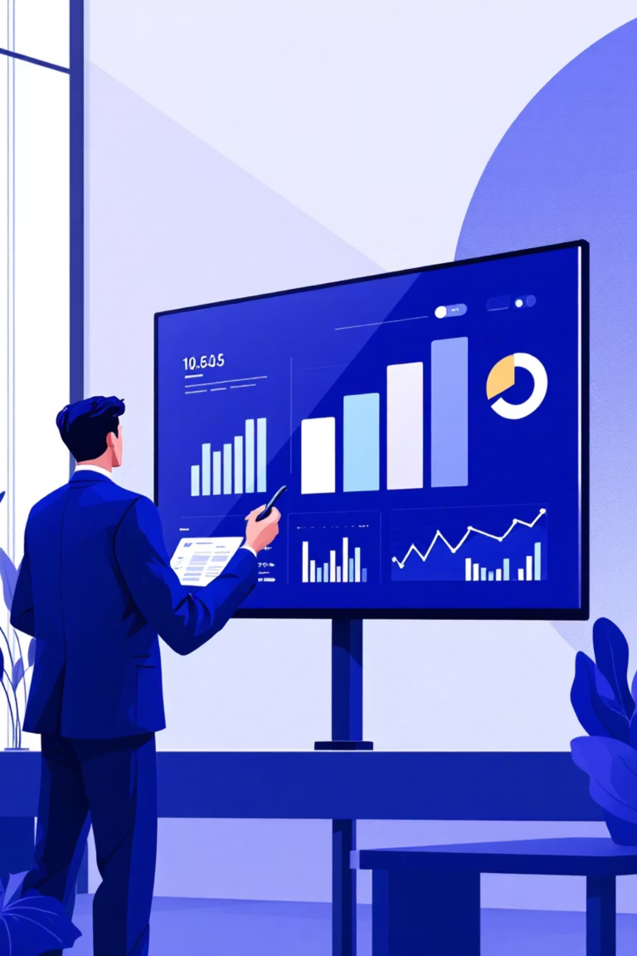
Milestone 4: Report and Presentation
1
Week 7: Dashboard Development
Assemble a coherent narrative from visualizations and build an interactive Tableau or Power BI dashboard featuring dynamic filters for age band, gender, and location type. Ensure all titles, labels, legends, and axes are crystal clear for stakeholder comprehension.
2
Week 8: Documentation & Delivery
Create comprehensive final report (PDF/README format), develop presentation slide deck with key insights highlighted, and prepare walkthrough demonstrations of dashboard interactions. Package all assets in organized repository.

Slide 9
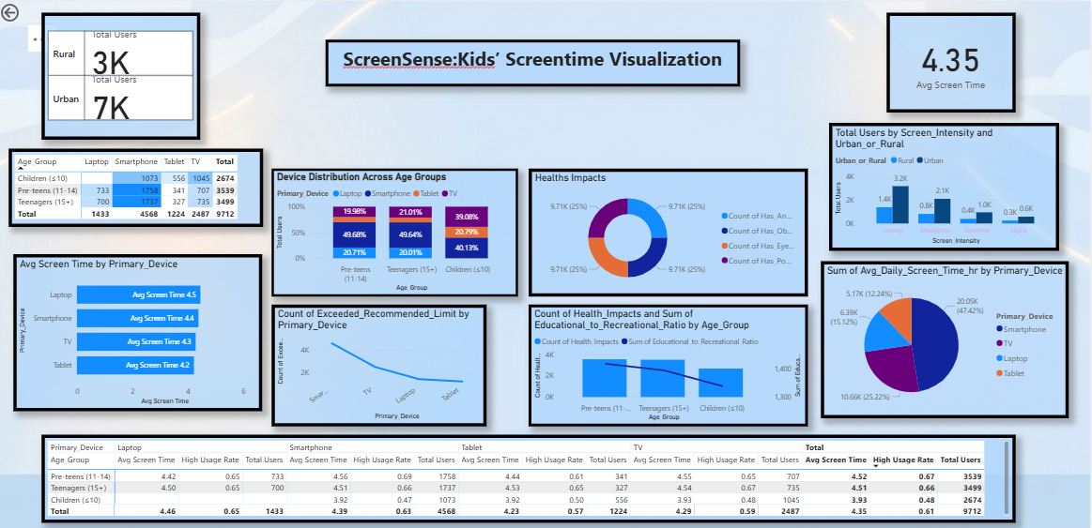

Final Dashboard

